Slide 1
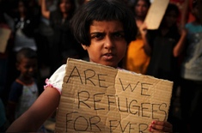
Refugee Week
Lizelle Eugenio

Slide 2
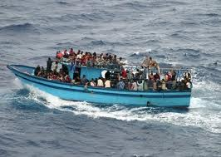
What is a Refugee
People from different places around the country that are seeking a place to stay are called refugees. They want to do this for multiple reasons that mainly come back to having a good life. Sometimes they want to seek refuge in times of war and some just want the best for their families. These people usually come on boats and are usually separated from their families. Refugees don’t get a say in where they go and some that are unfortunate die along the way. When coming to the different countries, they have to undergo tests and examinations to make sure their safe to be in their country. Some are automatically thrown into detentions centres. (Christmas Island is a detention centre) There have been many arguments to this case because many people think it’s not safe or the right thing to do.

Slide 3
Start of Timeline

Slide 4
Countries
Brazil
Canada
Egypt
Iraq
Kenya
New Zealand
Philippines
South Africa

Slide 5
1837
The First Canadian migrants did not come over to Australia by choice. They were exiles transported in 1837. This was after rebellion in in their homeland.

Slide 6
1840
When New Zealand was declared a British Colony in 1840, there were a number of exchanges of people across the Tasman Sea.
In 1880 New Zealanders had become depressed causing thousands of people to come to Victoria.
When doing this, all of them were is search of work

Slide 7
1871
In 1871, The Victorian census for Brazilians migrating to Victoria reached 45 people. Later in 1980 the Commonwealth refugee and humanitarian programs in Victoria saw the big change in numbers (550 in 1991). Most Brazil-Born Victorians usually migrated by the influence of family or personal situations.

Slide 8
1901
Kenya was known as British East Africa, In the late 19th Century. They were first recorded in the Victorian census in 1901. This was when one Kenya-born male was residing in Victoria. Over the years, Kenyans were not recorded again until 1981.

Slide 9
1911
In our history, there has been strong links between Australia and South Africa after colonization. Ever since the Gold rush was known in South Africa in the 1850’s, Victoria attracted more South Africans to flee to their country. 754 South Africans were living in Victoria when they first recorded the Australian census in 1911.

Slide 10
1949
After World War II, The war time refugees removal act forced the deportation for Filipinos and other Asians who have fled Japanese invasions of their homeland in 1949
White Australian Policy in the 1950 saw the arrival of Filipinos students under the Colombo Plan
Filipinos who were skilled enough tradesmen were recruited from the Philippines to work in Australia

Slide 11
1976
Immigrants from Iraq were first identified in the Victorian Census in 1976. This was when 189 people were recorded down. Over the years, the numbers increased by plenty that when reaching 1991, it had increased to a number of 603

